Slide 1
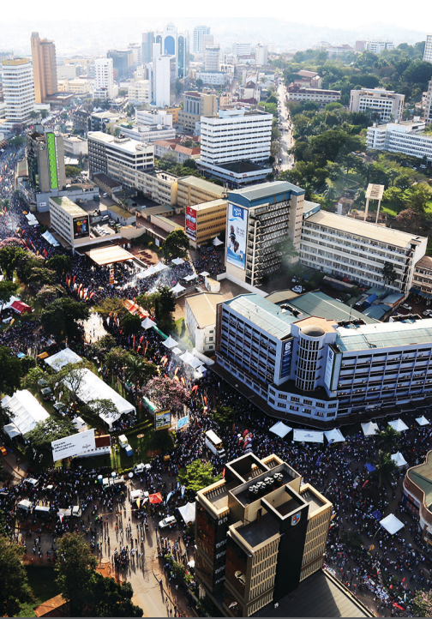



Seizing opportunities for implementing the KMGBF in urban Africa:
Biodiversity integration into Kampala`s climate action plan

Slide 2
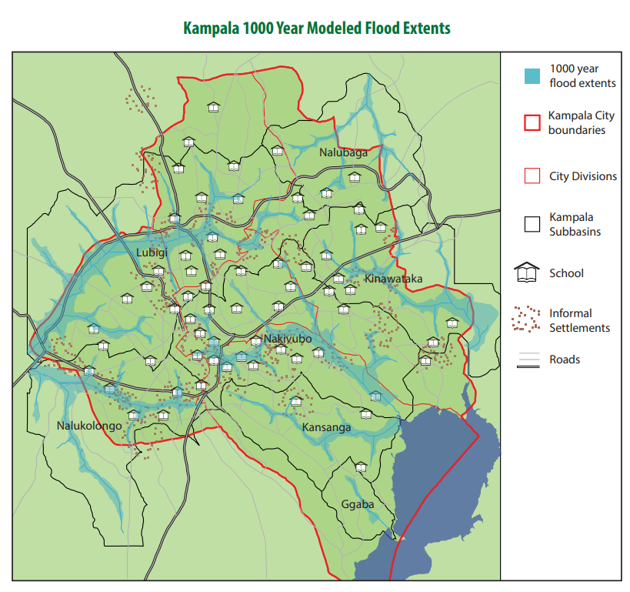
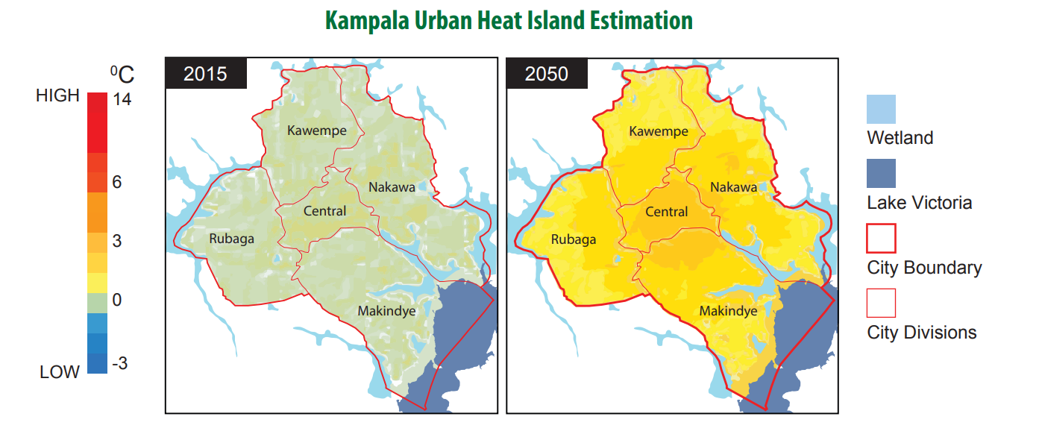
BIODIVERSITY FRAMEWORK
EU SUPPORT__________________________
Kampala´s climate vulnerabilities
TRANSFORMATIVE ACTIONS.
TOGETHER FOR NATURE AND PEOPLE. ________________

Slide 3
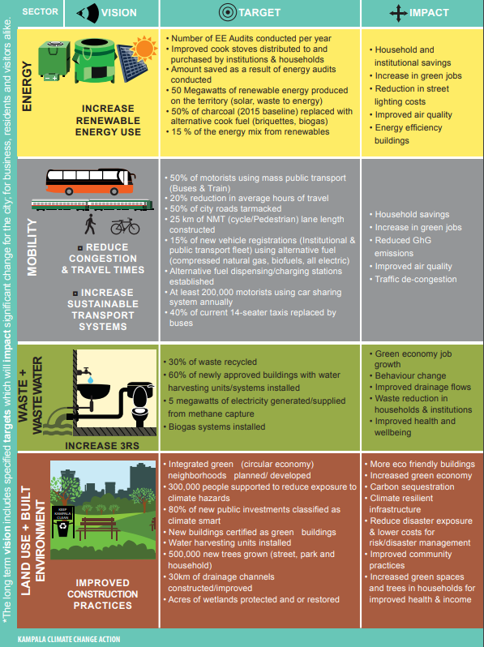
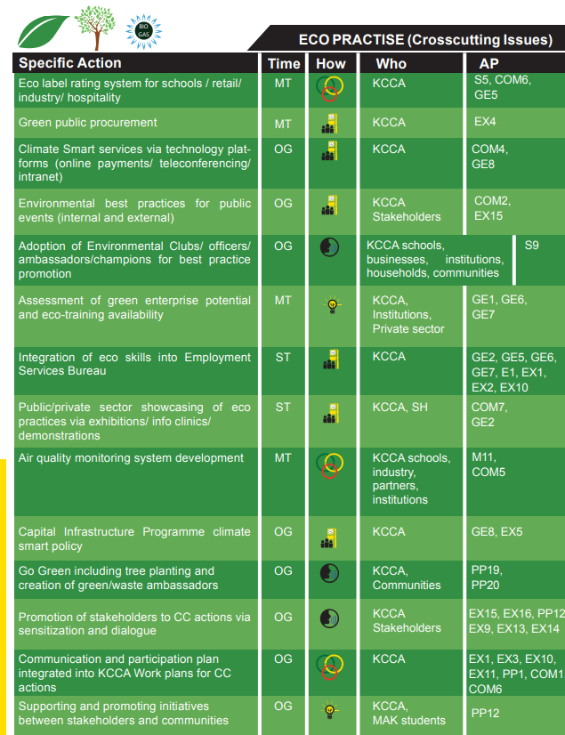
BIODIVERSITY FRAMEWORK
EU SUPPORT__________________________
Kampala climate change action plan (KCCAP) 2016-2023
TRANSFORMATIVE ACTIONS.
TOGETHER FOR NATURE AND PEOPLE. ________________

Slide 4
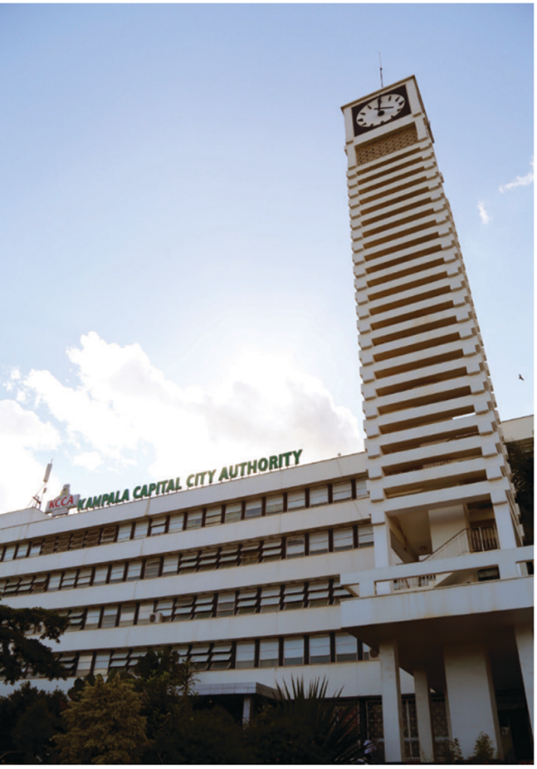
BIODIVERSITY FRAMEWORK
EU SUPPORT__________________________
Kccap update 2023-2030: opportune moment to implement the KMGBF
external evaluation (Breek Consult Limited/ COMSSA)
recommendations for update due November 2023
validation with broad range of stakeholders
support integrating biodiversity issues into evaluation and update (Expertise France)
  aim: actionable recommendations to integrate biodiversity-relevant approaches that provide multiple benefits for the climate- biodiversity-society nexus
  based on: document review & interviews with key stakeholders (local and national context-specific knowledge and perceptions)
TRANSFORMATIVE ACTIONS.
TOGETHER FOR NATURE AND PEOPLE. ________________
Notes:
Urban climate and biodiversity challenges are deeply intertwined. Integrating biodiversity into an existing climate-related action plan opens avenues for the creation of synergies and upscaling, and offers opportunities to advance in leveraging the climate-biodiversity-society nexus, which is fundamental to the delivery of the post-2020 GBF.

Slide 5
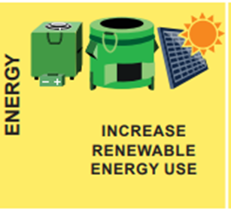
BIODIVERSITY FRAMEWORK
EU SUPPORT__________________________
Stronger integration of nature-based solutions as prerequisite for biodiversity
foster urban agriculture (≠ chemical pesticides
green roofs/facades
private sector engagement
waste-to-wealth; biogas; organic manure
NBS-based greywater treatment
SUDs: permeable paving
road construction & greening
targeted greening for pollinators, stormwater runoff & GHG capture
eco-tourism parks
TRANSFORMATIVE ACTIONS.
TOGETHER FOR NATURE AND PEOPLE. ________________

Slide 6
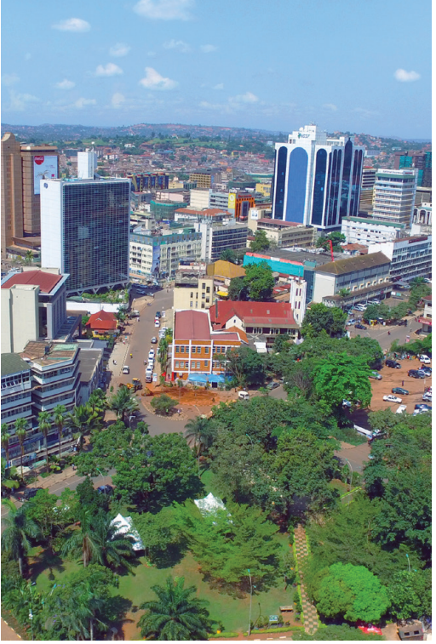
BIODIVERSITY FRAMEWORK
EU SUPPORT__________________________
Recommendations
actions must trickle down to benefit informal settlements
increase capacity of KCCA (urban forestry; monetize value of ES; KMGBF)
tap into existing knowledge and data of NGOs on biodiversity
improve horizontal and vertical institutional collaboration
seize opportunities to further rally stakeholders:
  faith-based and traditional entities (e.g., Buganda Kingdom)
  youth networks
  private sector
increase awareness of the KCCAP
TRANSFORMATIVE ACTIONS.
TOGETHER FOR NATURE AND PEOPLE. ________________

Slide 7
BIODIVERSITY FRAMEWORK
EU SUPPORT__________________________
Katharina Rochell
Urban Resilience Expert
Expertise France
katharina.rochell@gmail.com
Katharina Rochell
k.rochell@uu.nl
TRANSFORMATIVE ACTIONS.
TOGETHER FOR NATURE AND PEOPLE. ________________

Slide 8



